Slide 1
Spring Security
2021

Slide 2
What is Security?
Protecting and business logic inside business logic.
It non functional like performance, availability.

Slide 3
Types of Security?
Firewalls
Https
SSL
Authentication
Authorization

Slide 4
Why Security?
It avoids most common security attack like
CSRF,
Broken Authentication inside your application.

Slide 5
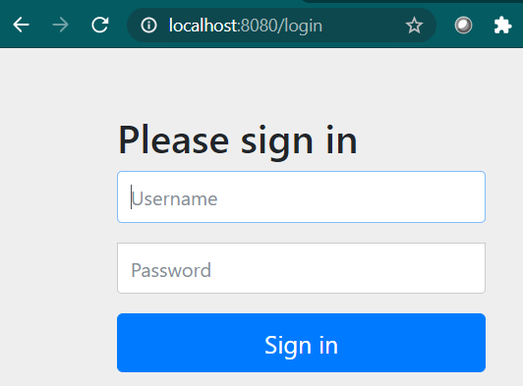
Spring Security Example
Create Spring Boot Starter Project
Add dependency – Spring Web, Devtools, Spring Security
Add a @RestController for home mapping
Run it at 8080
Enter user name: user
Read the Password from console and paste on password login page

Slide 6
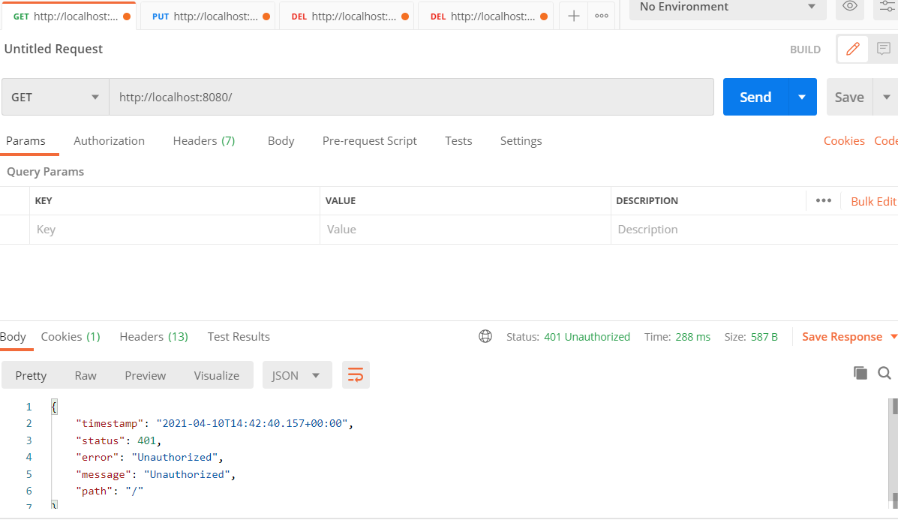
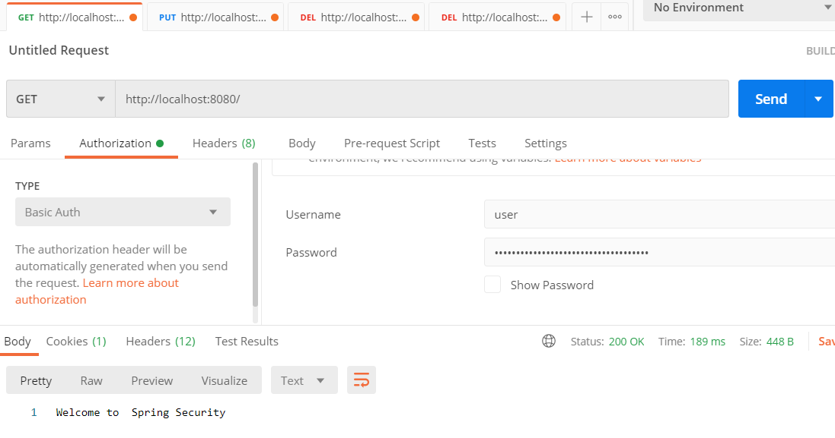
Spring Security - Postman
Use case 1: Without authentication
Use Case 2: With Authentication (Basic Auth)
Notes:
It is considering whatever I have entered previously.
So this is the power of spring security.
By default, it is providing to you.
And you can imagine how powerful this framework can be if you configure as per your custom requirements.
So this is one of the challenges that we always think.
Right.
So how do I can avoid my user to enter same credentials again and again for multiple requests that he's
called?
So this is the answer for that to show you how this is working the back.
And let's quickly go to the postman application.
Walsman is an application where we can call and test our apps.
Let's try to call the same app that we have developed, which is using Posman to understand what is
happening in the back.
So now I click on Create a Request and I'll go with a get option only because our supports September
3rd, if we can remember in the code, we have used to get mapping annotation, which indicates our
app supports getting better.
Now try to call the API, giving the endpoint you warrant and click on the Senate.
Estimates that I get will be for not one which is an authorized user.
Since we said the welcome part has to be protected, the spring security is trying to protect it by
validating my credentials.
So in this scenario, I have not entered any correction.
That's why it is giving me the response of four, not one which is on potteries.
In the case of Broza, previously we have seen it has redirected to login page.
That means our spring security is smart enough to identify whether my request is coming from a browser
or some Bakan.
So in this scenario, since we are calling from Posman, which is like simulating calling directly the
app, it is giving me the simple response, saying that you are not authorized person to call this app.
So now what I will do is I will try to add security by providing my credentials to you, by selecting
basic auth under authorization app.
And I have entered my credentials here.
If I click send now, I should get that response, which you used to be to in the browser.
So now we see that we receive the same response as in browser.
Now I'll try to call the same API by clicking on same and as expected will get the response which we
already receive to make things understanding.
I will go and remove the ID details, which means the next time that I'm going to send the API request
to my back and I'm not providing my credentials.
Surprisingly, even without credentials, I'm getting a valid response like an automatic an authorized
user.
So what is happening really in the backend?
So whenever we are making a request to your backend spring security, so what will happen is it will
give you an idea of talking to you.
That means that token will be shared for all for the request so that we have an advantage here where
we don't have to ask the user.
We don't have to store the user credentials every time to pass or the network, which is a security
issue.
So how this is working.
So if we go and see the cookies, so this is the idea that I have resumed as soon as my self authenticated,
the idea will be also shared in the scenarios where I'm not authorized.
Also, these ideas will be stored at the shipping container level and each ID it will store whether
this ideas are valid, authenticated user are not valid, authenticated user.
So now to make things clear, I will go ahead and remove this cookie.
Just go to cookies and I'm deleting this cookie.
That means now we don't have any credentials.
I'm tired and we don't have cookie also that we received initially.
And clicking on this send will get me for not one unauthorized user.
That means I didn't provide my credentials.
And at the same time I removed the cookie of the idea token that I received from the backend during
very first time.
And you can see the token now.
Also, I presume that means this token is an invalid token from the back.
And if I go ahead and call with the same no other details, I will get the same token every time because
there is nothing changed from a security perspective.
So this time I'll go and add authentication details again.
And you can see now the token I will change.
Right now it is starting with nine to be.
And as soon as I click and send the token, I will change to main three.
That means the previous token is invalid and this token is invalid, removing the authentication details.
And since I have this cookie going in my head that every time, which is 98, my spring security server
will give me a response of welcome from spring application with security, which we coded in the back.
So this is how things works internally.
I hope you are understanding how spring security provides all the features of not sharing the credentials
for each and every request.
And at the same time, I also not only to spring security or spring container that you have to protect
my welcome at.
Not conflict.
No, I just added it as a dependency by default, the spring container will protect all the airspace
associated inside an application.
But this is how the default behavior of things are making sense to you.
We'll catch you next week.
Thank you.

Slide 7
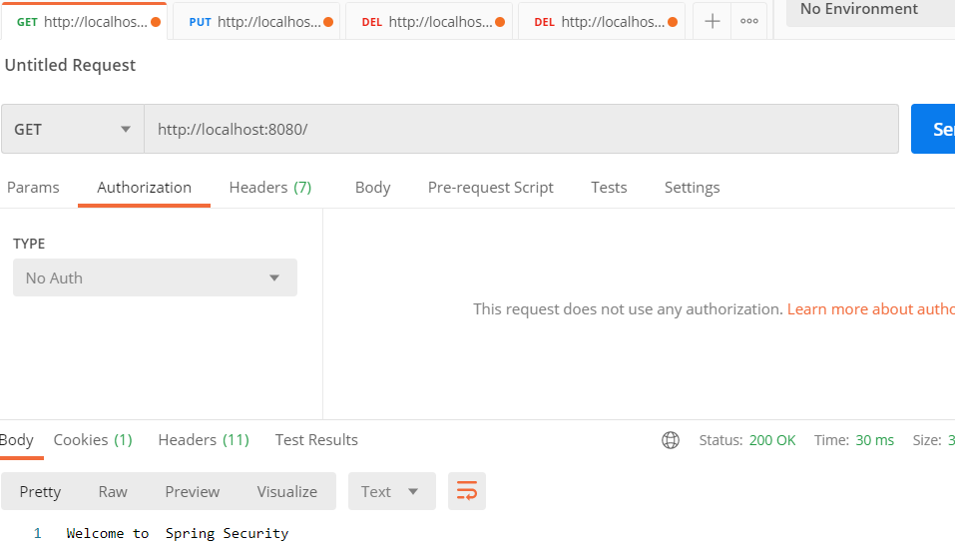
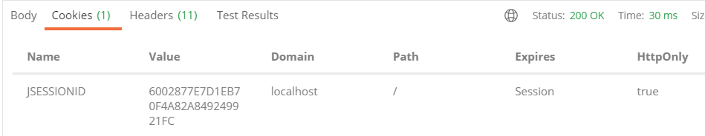
Spring Security - Postman
Use Case 3: Without authentication (No Auth)
Select NO AUTH from Authorization tab
Enter url and click on send.
It will still give the result
Reason :
When first time it was hit with credentials it stores on
Cookies. So when you hit url with NO auth then it reads
Cookies for stored jSessionID. Same session id
Is going to be shared for all requests
Notes:
It is considering whatever I have entered previously.
So this is the power of spring security.
By default, it is providing to you.
And you can imagine how powerful this framework can be if you configure as per your custom requirements.
So this is one of the challenges that we always think.
Right.
So how do I can avoid my user to enter same credentials again and again for multiple requests that he's
called?
So this is the answer for that to show you how this is working the back.
And let's quickly go to the postman application.
Walsman is an application where we can call and test our apps.
Let's try to call the same app that we have developed, which is using Posman to understand what is
happening in the back.
So now I click on Create a Request and I'll go with a get option only because our supports September
3rd, if we can remember in the code, we have used to get mapping annotation, which indicates our
app supports getting better.
Now try to call the API, giving the endpoint you warrant and click on the Senate.
Estimates that I get will be for not one which is an authorized user.
Since we said the welcome part has to be protected, the spring security is trying to protect it by
validating my credentials.
So in this scenario, I have not entered any correction.
That's why it is giving me the response of four, not one which is on potteries.
In the case of Broza, previously we have seen it has redirected to login page.
That means our spring security is smart enough to identify whether my request is coming from a browser
or some Bakan.
So in this scenario, since we are calling from Posman, which is like simulating calling directly the
app, it is giving me the simple response, saying that you are not authorized person to call this app.
So now what I will do is I will try to add security by providing my credentials to you, by selecting
basic auth under authorization app.
And I have entered my credentials here.
If I click send now, I should get that response, which you used to be to in the browser.
So now we see that we receive the same response as in browser.
Now I'll try to call the same API by clicking on same and as expected will get the response which we
already receive to make things understanding.
I will go and remove the ID details, which means the next time that I'm going to send the API request
to my back and I'm not providing my credentials.
Surprisingly, even without credentials, I'm getting a valid response like an automatic an authorized
user.
So what is happening really in the backend?
So whenever we are making a request to your backend spring security, so what will happen is it will
give you an idea of talking to you.
That means that token will be shared for all for the request so that we have an advantage here where
we don't have to ask the user.
We don't have to store the user credentials every time to pass or the network, which is a security
issue.
So how this is working.
So if we go and see the cookies, so this is the idea that I have resumed as soon as my self authenticated,
the idea will be also shared in the scenarios where I'm not authorized.
Also, these ideas will be stored at the shipping container level and each ID it will store whether
this ideas are valid, authenticated user are not valid, authenticated user.
So now to make things clear, I will go ahead and remove this cookie.
Just go to cookies and I'm deleting this cookie.
That means now we don't have any credentials.
I'm tired and we don't have cookie also that we received initially.
And clicking on this send will get me for not one unauthorized user.
That means I didn't provide my credentials.
And at the same time I removed the cookie of the idea token that I received from the backend during
very first time.
And you can see the token now.
Also, I presume that means this token is an invalid token from the back.
And if I go ahead and call with the same no other details, I will get the same token every time because
there is nothing changed from a security perspective.
So this time I'll go and add authentication details again.
And you can see now the token I will change.
Right now it is starting with nine to be.
And as soon as I click and send the token, I will change to main three.
That means the previous token is invalid and this token is invalid, removing the authentication details.
And since I have this cookie going in my head that every time, which is 98, my spring security server
will give me a response of welcome from spring application with security, which we coded in the back.
So this is how things works internally.
I hope you are understanding how spring security provides all the features of not sharing the credentials
for each and every request.
And at the same time, I also not only to spring security or spring container that you have to protect
my welcome at.
Not conflict.
No, I just added it as a dependency by default, the spring container will protect all the airspace
associated inside an application.
But this is how the default behavior of things are making sense to you.
We'll catch you next week.
Thank you.

Slide 8
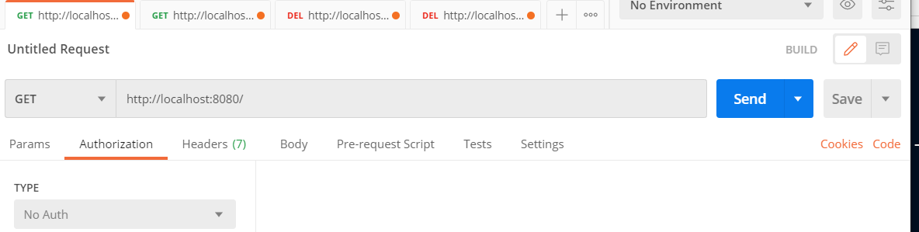
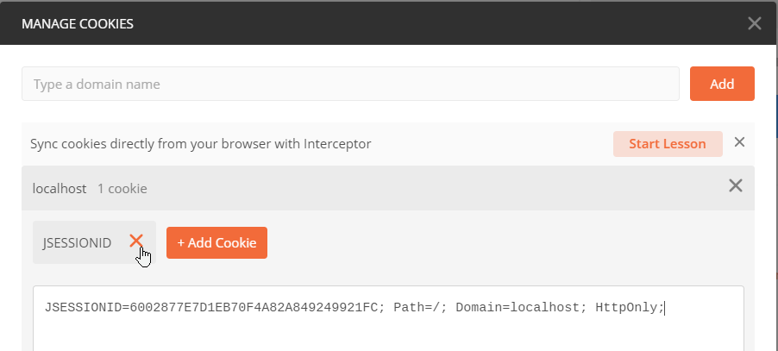
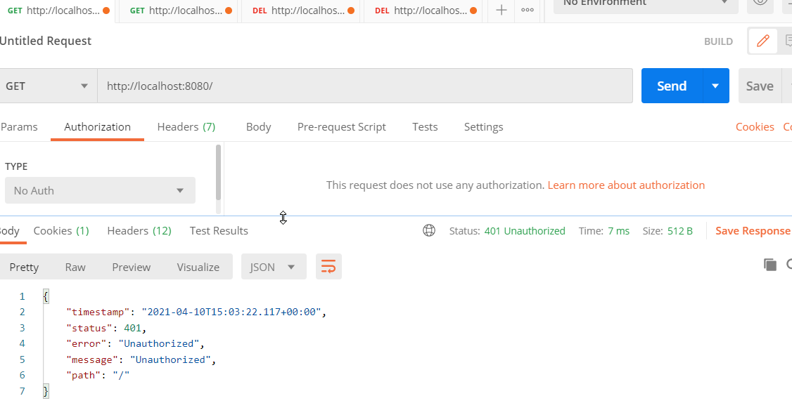
Spring Security - Postman
Use Case 4: Without authentication (No Auth) – Delete Cookie Test
Go to postman
Enter url and select - No auth
Click on Cookies
Delete Cookies
Enter url and test again
Note: By default it applies the security on all URL
Notes:
It is considering whatever I have entered previously.
So this is the power of spring security.
By default, it is providing to you.
And you can imagine how powerful this framework can be if you configure as per your custom requirements.
So this is one of the challenges that we always think.
Right.
So how do I can avoid my user to enter same credentials again and again for multiple requests that he's
called?
So this is the answer for that to show you how this is working the back.
And let's quickly go to the postman application.
Walsman is an application where we can call and test our apps.
Let's try to call the same app that we have developed, which is using Posman to understand what is
happening in the back.
So now I click on Create a Request and I'll go with a get option only because our supports September
3rd, if we can remember in the code, we have used to get mapping annotation, which indicates our
app supports getting better.
Now try to call the API, giving the endpoint you warrant and click on the Senate.
Estimates that I get will be for not one which is an authorized user.
Since we said the welcome part has to be protected, the spring security is trying to protect it by
validating my credentials.
So in this scenario, I have not entered any correction.
That's why it is giving me the response of four, not one which is on potteries.
In the case of Broza, previously we have seen it has redirected to login page.
That means our spring security is smart enough to identify whether my request is coming from a browser
or some Bakan.
So in this scenario, since we are calling from Posman, which is like simulating calling directly the
app, it is giving me the simple response, saying that you are not authorized person to call this app.
So now what I will do is I will try to add security by providing my credentials to you, by selecting
basic auth under authorization app.
And I have entered my credentials here.
If I click send now, I should get that response, which you used to be to in the browser.
So now we see that we receive the same response as in browser.
Now I'll try to call the same API by clicking on same and as expected will get the response which we
already receive to make things understanding.
I will go and remove the ID details, which means the next time that I'm going to send the API request
to my back and I'm not providing my credentials.
Surprisingly, even without credentials, I'm getting a valid response like an automatic an authorized
user.
So what is happening really in the backend?
So whenever we are making a request to your backend spring security, so what will happen is it will
give you an idea of talking to you.
That means that token will be shared for all for the request so that we have an advantage here where
we don't have to ask the user.
We don't have to store the user credentials every time to pass or the network, which is a security
issue.
So how this is working.
So if we go and see the cookies, so this is the idea that I have resumed as soon as my self authenticated,
the idea will be also shared in the scenarios where I'm not authorized.
Also, these ideas will be stored at the shipping container level and each ID it will store whether
this ideas are valid, authenticated user are not valid, authenticated user.
So now to make things clear, I will go ahead and remove this cookie.
Just go to cookies and I'm deleting this cookie.
That means now we don't have any credentials.
I'm tired and we don't have cookie also that we received initially.
And clicking on this send will get me for not one unauthorized user.
That means I didn't provide my credentials.
And at the same time I removed the cookie of the idea token that I received from the backend during
very first time.
And you can see the token now.
Also, I presume that means this token is an invalid token from the back.
And if I go ahead and call with the same no other details, I will get the same token every time because
there is nothing changed from a security perspective.
So this time I'll go and add authentication details again.
And you can see now the token I will change.
Right now it is starting with nine to be.
And as soon as I click and send the token, I will change to main three.
That means the previous token is invalid and this token is invalid, removing the authentication details.
And since I have this cookie going in my head that every time, which is 98, my spring security server
will give me a response of welcome from spring application with security, which we coded in the back.
So this is how things works internally.
I hope you are understanding how spring security provides all the features of not sharing the credentials
for each and every request.
And at the same time, I also not only to spring security or spring container that you have to protect
my welcome at.
Not conflict.
No, I just added it as a dependency by default, the spring container will protect all the airspace
associated inside an application.
But this is how the default behavior of things are making sense to you.
We'll catch you next week.
Thank you.

Slide 9
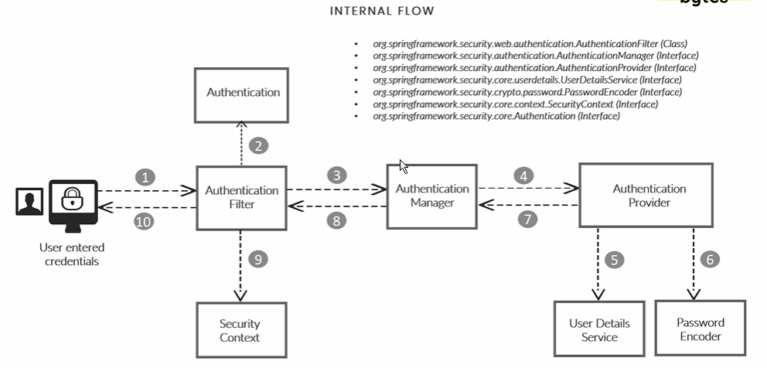
Spring Security Flow
Notes:
Authentication Filter: It intercepts the requests and converts the authentication credentials to Authentication object.
Authentication : It is base where all the credentials are going to be validated for further validated.
Authentication Manager: Place where it will identify what is the most authentication provider where request has to be send. You may use DB , LDAP, Oauth.
Authentication Provider : There can be some scenarios where you receive a mobile number as a username and password.
So based upon all such scenarios, you will implement all your logic of security validation inside your
authentication provider and authentication provider.
Interns will use to the interfaces.
One is user details services and other one is password.
And the user data services is the interface which holds user schema, like how my user details should
look like.
It might be a scenario where my user eHow username password or T.P artifact ID all that schema.
I will identify under my user and user details, services and password and current user interface,
which will tell all my passwords has to be encrypted.
Encoded are decrypted while evaluating the security, provides many passwords and codes which will be
seen in the coming sections.
Decrypt password and coder, no password and caught in the scenarios where we don't want our password
to be encoded encrypted.
All possible password codes are available in security, which will be seeing in the coming sections.
Once authentication provider using user detail services and password encoder validator with the input
potentials are valid or not, the floor will be given back to the indication manager honored by the
authentication printer.
Now my authentication object, which I initially sent from my filter rehaul, whether the user is a
valid, authenticated user, what are the authorities or what are the rules associated to it?
Inside my authentication object, once my authentication filter, this my authentication object, which
is populated from authentication provider manager, which is seen in the step eight, this authentication
free that will pass that authentication object to security can explain my details will be stored inside
the container.
If you remember in the previous version, there is a token packet children.
So in this scenario, application will hold the.
Which will be stored inside my spring container using security context, interface,
9. Security context-
is the place where we see the data of the user once he or she authenticate themself, can be it might
be a valid user or she might not be a valid user.
All sorts of details will be stored inside the security context given back to the browser from second
time onwards.
If they are trying to pass the same security information, all this flow will not be executed because
we already tried to validate the person using that credentials.
Enter and spring security will tell you, OK, using this token, whatever I am receiving from second
time onwards, that is a valid token or invalid token.
This is how it works internally in spring security framework.
If there is a scenario where I can remember only one slide in this entire course, this is one of the
slide that I will choose to remember because this is a base for entire spring security and we will discuss
each component by component how to configure according to our custom requirements in the coming sessions.

Slide 10
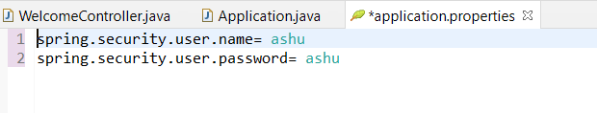
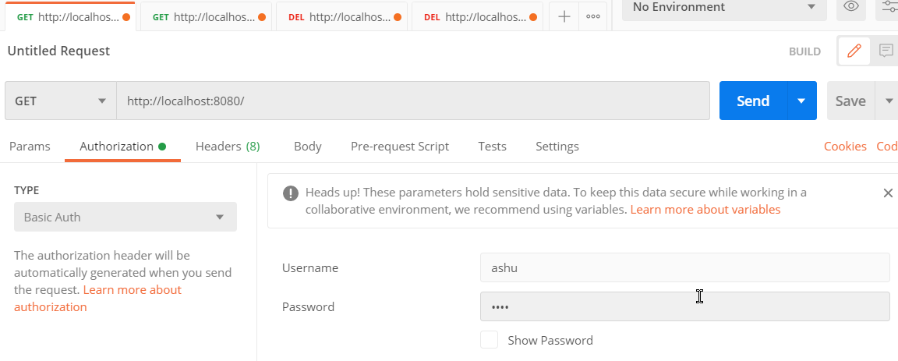
Customize the Spring Security
Note: ByDefault all request are needs authentication

Slide 11
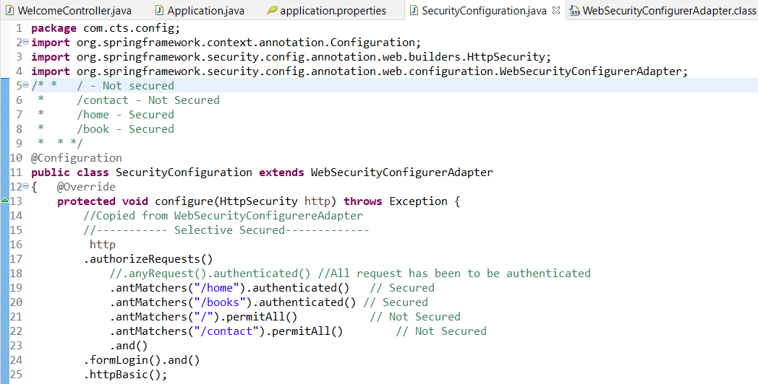
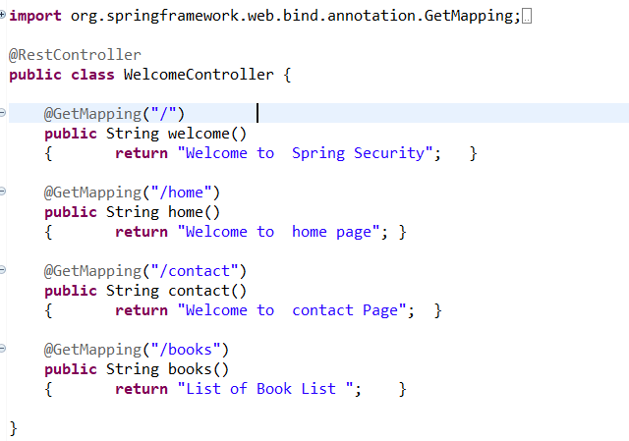
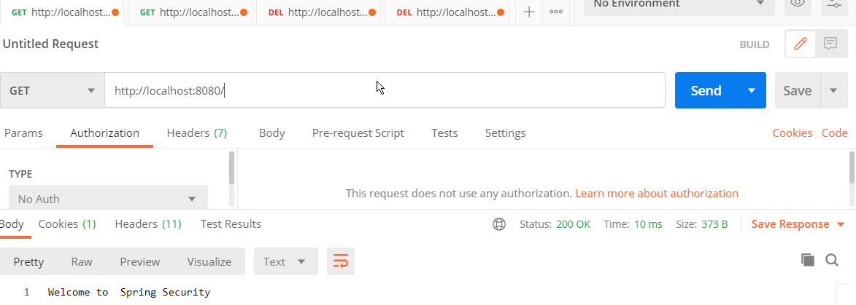
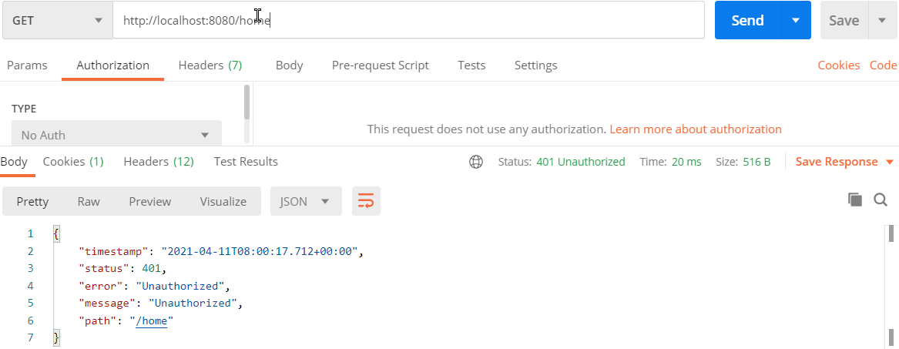
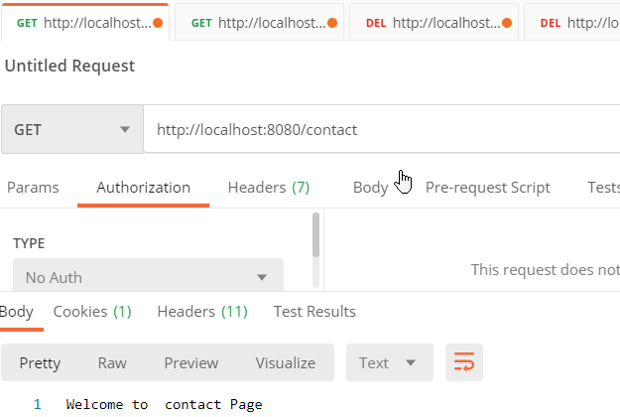
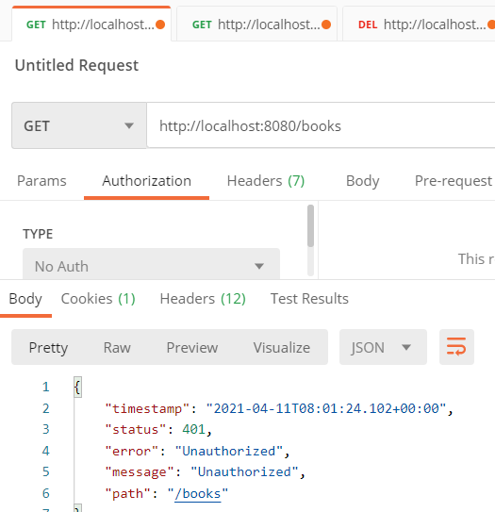
Spring Security –Customization - Selective Pages
Apply authorization for /home and /books .
/ and contact NO need for authorization.

Slide 12
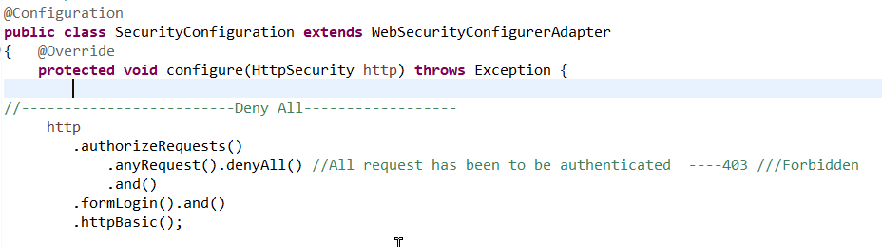
Spring Security-Customization – Deny All
Delete the cookies from postman and test.

Slide 13
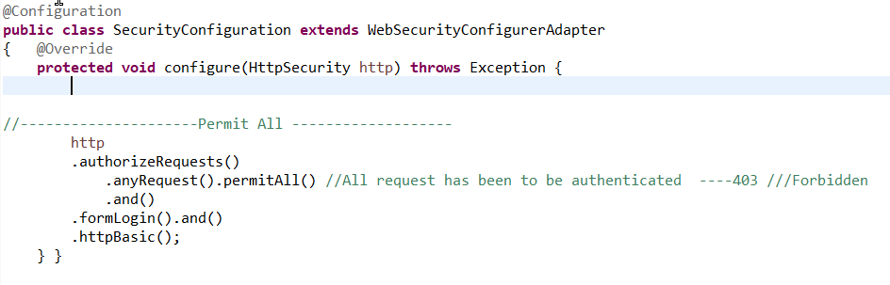
Spring Security –Customization - Permit All
Accept all the request and no need the credentials

Slide 14
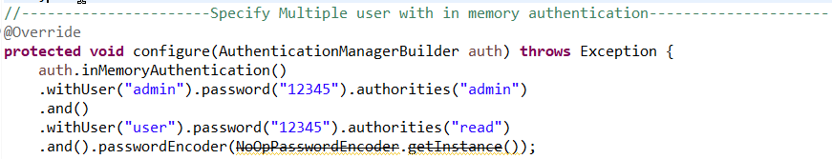
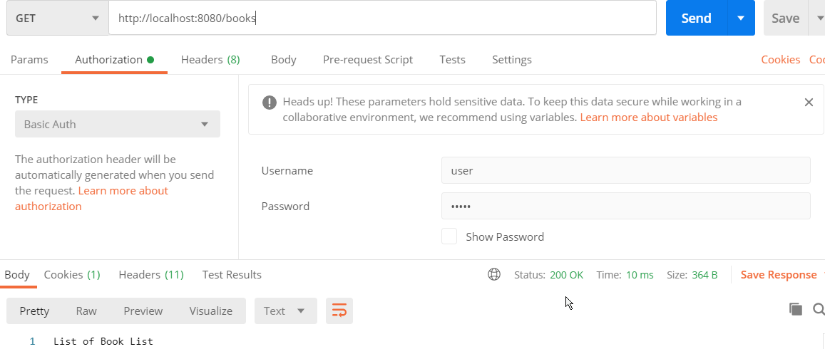
Spring Security – InMemory – Multiple user Authentication
Credentials mentioned in properties are not applicable now.

Slide 15
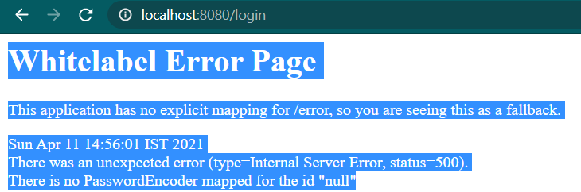
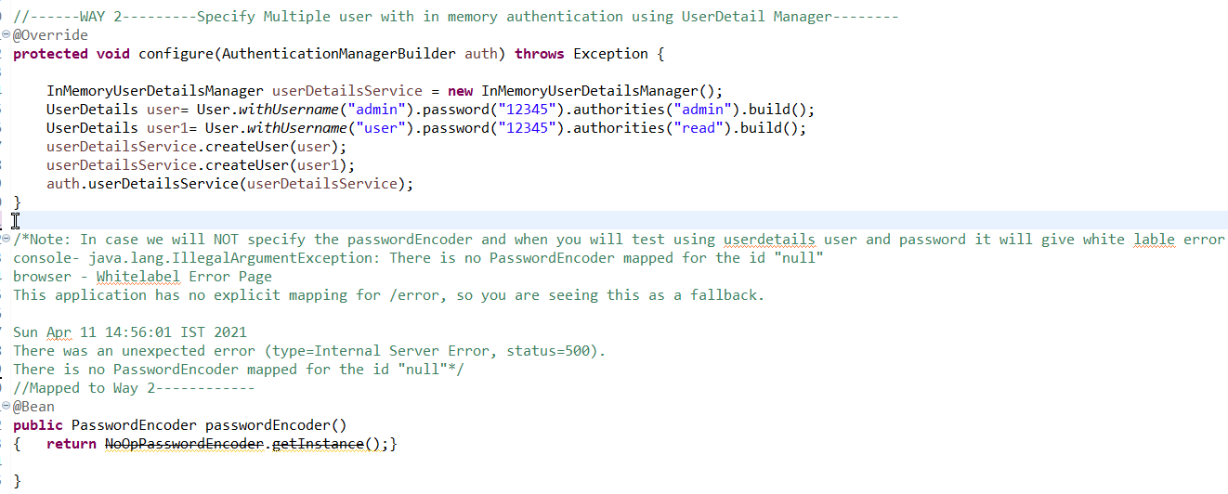
Spring Security –InMemory – UserDetailsService – WAY 2
In case passwordencoder not specified with UserDetails -> White label error

Slide 16
Spring Security
Enter Username / Password + submit
Calls loadUserByUserName() from UserDetailsService interface which checks valid user credentials
Issues:
Integrity Issue – Table stores password in DB and visible to DBA
Confidentiality - Password travels with plain text over network.

Slide 17
Authentication and Authorization
AUTHENTICATION
Process of identifying an individual using credentials
Username and password
Tokens
Biometrics
AUTHORIZATION
Process of granting someone access to resource
File
Record
Database

Slide 18
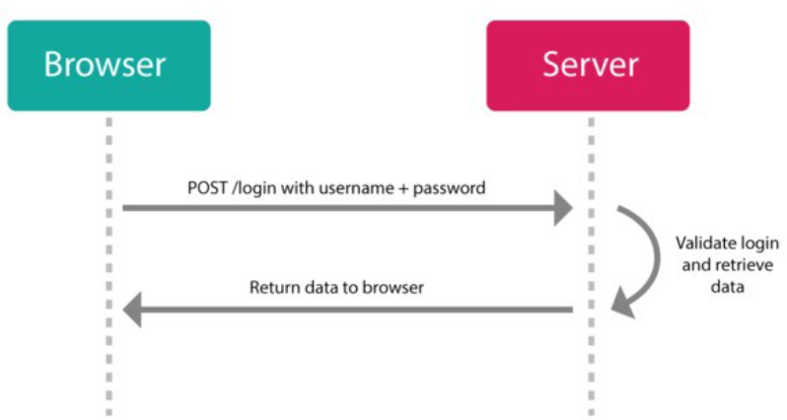
Before JWT
HTTP is a stateless protocol
That means it doesn’t remember anything from request to request.
If you login for one request, you’ll be forgotten, and will need to login again to make another request.

Slide 19
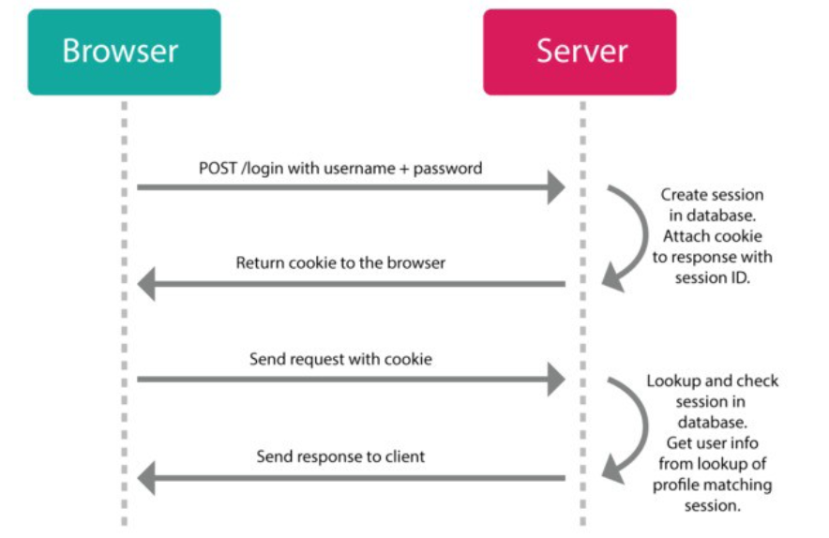
Solution of HTTP (Stateless)
Session
Part 1: An object stored on the server that remembers if a user is still logged in, a reference to their profile, etc.
Part 2: A cookie on the client-side that stores some kind of ID that can be referenced on the server against the session object’s ID.
Notes:
If a user visits a web page (makes a request) and the server detects a session cookie, it will check if it currently has a session stored with the ID from the cookie, and if that object is still valid (whatever that means: not expired, not revoked, not blacklisted, etc).
If the session is still valid, it will respond with the requested web page (or data). If it finds a session object, that object can contain data in it and with that, the server can “remember” who you are and what you were doing (e.g. if this is an ecommerce store, what products you’ve added to our shopping cart).
If the session is not valid (or no session cookie was detected) it will respond with some sort of error message saying that the request is “unauthorized”.
New sessions can typically be created by sending a username/password combination to a specific endpoint from a login page. If the server can match a user with that username and password, it will generate a new session object on the server and set a cookie on the client with the session’s ID for any future requests.
If a user turns off their computer and comes back to the website some time in the future, s/he can either automatically log in again (if there is still a cookie in the browser that hasn’t expired) or log in again through the login page. Once logged in, the user’s session can be retrieved again from the data stored on the server, and the user can go on with their business (e.g. continuing to shop after reloading your shopping cart).
This type of setup has worked pretty well for us since the web came out and since we’ve been visiting web sites that do most of their “thinking” on the server side. Typically, this has been a conversation between the user’s front-end browser and a corresponding back-end server in a one-to-one relationship.

Slide 20
Issues with Session based authentication
Multiple Backends
Multiple Dbs, Micro service architecture -> Increase complexity in inter server comm.
Session
Store it in memory or Database and key value
Needs to manage session either remove or expire or invalidate.
Poor Scalability
The store uses up resources, and adds complexity.
Performance Issues
a lot of database/store lookups need to happen on every request which can bog down the server.
CORS
Cookies + CORS don’t play well across different domains

Slide 21
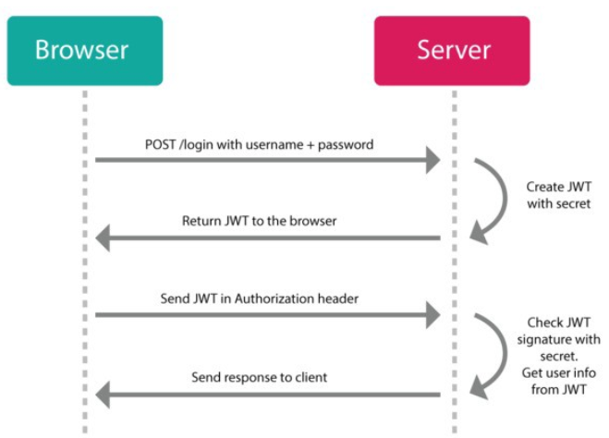
JWT
The server will send you a JSON Web Token

Slide 22
How JWT works?
Header
{typ: ‘JWT’, alg: ‘HS256’}
Payload
JSON object of data
{userId: 2} or maybe even {userId: 2, admin: true})
Signature
Hash of the encoded header, the encoded payload, and a “secret” key that you provide (stored safely on the server) using the algorithm defined in the header.
Eg: xxxxxxxx.yyyyy.zzzzzzzz
https://jwt.io/

Slide 23
JWT
Generation of Token – Username/Password (POST)
Validation of Token – Within Header

Slide 24
Advantage of Token Based authentication
Help us not to share token with every request.
Token can be invalidating without invalidating the user credentials.
Token can be created with short span life span.
Token can store role and authorities etc.
Reusing same token for authenticating the user.

Slide 25
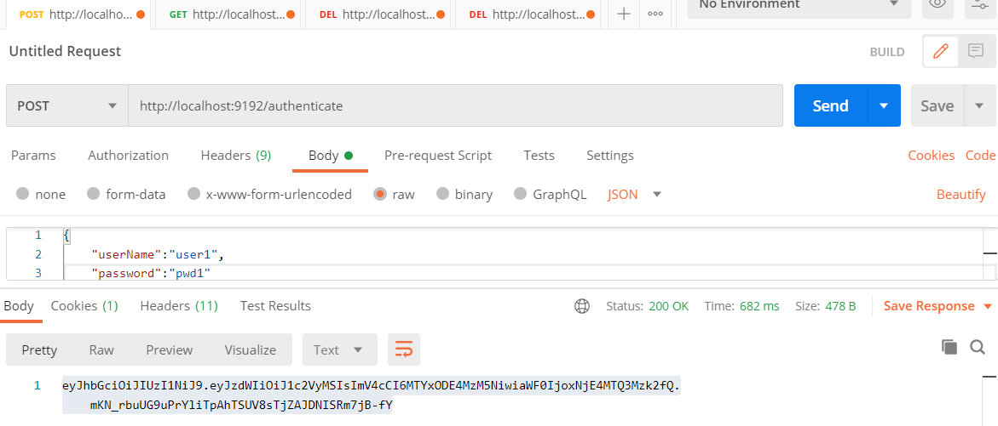
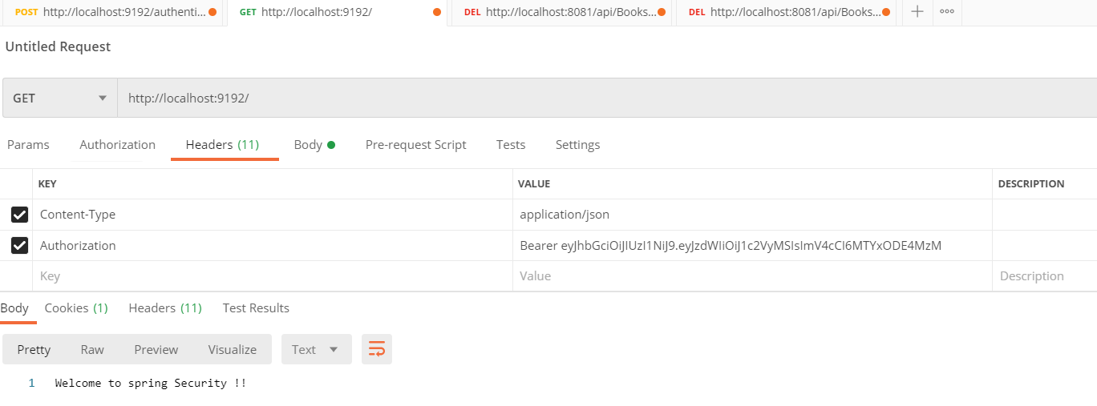
Spring Security Example

Slide 26
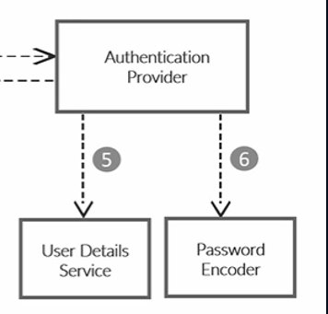
Configuring UserDetails Service
User detail service and password encoder are the important interfaces that helps in maintaining the user details and validating them.
That means if someone provides some credentials, these two user detail services and password and take The responsibility of validating whether the username and password entered by user is correct or not.

